Slide 1

Activating Your DAF-Donor Base: Strategies for Fundraising and
Planned Giving Success
Speaker, Fernando Gonzalez, VP, Development, East, National Philanthropic Trust
Speaker, Perry Monastero, Ed.D., The Nonprofit Center at La Salle University Instructor/Consultant and Principal at RPM Consulting Group
Notes:
Welcome everyone.
We're here to talk about how donor-advised funds, or DAFs, have transformed giving in the last decade, and more importantly, what that means for your fundraising and planned giving efforts.
Our goal is to help you meet donors where they already are: using DAFs.

Slide 2
The Rise of Donor-Advised Funds
Donor-advised funds (DAFs) have grown in popularity and use.
In the past decade alone, DAF Sponsors and Donors granted
over $300B globally
637% growth
in total DAF accounts since 2014, now over 1.8M
70% higher — Gifts to DAFs as a percentage of total giving in the U.S. is 70% higher than in 2014
Source: NPT’s Donor-Advised Fund Reports, 2015-2014; GivingUSA 2024 Report
Notes:
Over the past decade, donor-advised funds have emerged as a major philanthropic force.
More than $300 billion has been granted to nonprofits around the world through DAFs.
Since 2014, the number of DAF accounts has increased by 637%, reaching 1.8 million.
And DAF giving now represents a 70% larger share of all charitable giving in the U.S. than it did ten years ago.
This growth reflects not only the popularity of DAFs—but also their power to drive sustained, strategic philanthropy.

Slide 3
Agenda
How can you tap into this $250+ billion DAF opportunity?
Overview and opportunity
Engaging DAF donors
Use case: illiquid asset
Source: National Philanthropic Trust, 2024 DAF Report
Notes:
And that’s the opportunity we want to explore today.
According to NPT’s most recent Donor-Advised Fund Report—which analyzes IRS Form 990 filings from more than 1,100 public charities that sponsor DAFs—there are currently over $250 billion DAF assets.
In this session, we’ll look at how you can tap into that asset base by focusing on three key areas:
A brief refresher on how DAFs work, along with the latest data on DAF activity
Insights into what donors are doing with their DAFs—and how you can better connect with them
And a use case that highlights how DAF-centered strategies can lead to transformational giving

Slide 4

Overview and Opportunity

Slide 5

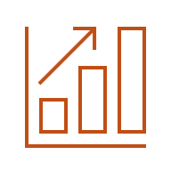





How Donor-Advised Funds Work
Donors contribute assets to DAF sponsors—which have 501(c)(3) status. They retain advisory status on the account and recommend grants to charity.
The DAF sponsor provides administration for the account, including detailed recordkeeping, sub-accounting, quarterly statements, and tax reporting.
  Donors Contribute
Donor makes an irrevocable contribution and can take an immediate tax deduction
Assets May Grow
The charitable assets
in the DAF may grow tax-free
Charities Benefit
Donor recommends
grants to qualified charities
Notes:
Let’s start with a quick level set on how donor-advised funds work.
At its core, a DAF is simply a giving account:
It’s owned and controlled by a public charity, known as the DAF sponsor.
The donor—or an advisor they appoint—has advisory privileges over how the funds are invested and distributed.
While DAFs have been around since the 1930s, they’ve grown significantly in the past decade because of their simplicity and flexibility.
DAF sponsors can include:
Community foundations
Public charities established by financial institutions
Single-issue charities like Jewish Federations or universities
And independent sponsors like NPT or American Endowment Foundation
Let’s walk through the typical DAF lifecycle:
First: Donors contribute.
They can contribute cash, marketable securities, or even complex assets like privately held business interests. It’s important to note: the charitable tax deduction is received at the time of contribution—because the donor is giving up legal control of the asset.
Next: The assets grow.
Donors can recommend how their DAF assets are invested, typically choosing from a menu of third-party investment options provided by the sponsor.
Finally: Charities benefit.
Donors can recommend grants to any qualified public charity, as long as the grant serves a charitable purpose. Some sponsors, like NPT, also allow for international grantmaking.
It’s also worth clarifying the language here:
Contributions go into the DAF—this is when the tax deduction is received.
Grants go out to charities—based on the donor’s recommendations.
While donors have advisory privileges, they no longer legally control the assets. That said, most sponsors approve grant recommendations as long as they meet IRS requirements and the sponsor’s own guidelines—such as geographic restrictions for regionally focused community foundations.

Slide 6

Growth in DAF Contributions
Five-year trend shows steady increase.
$59.43B
Contributions
Contributions to DAFs in 2023
9.4%
CAGR
Compound annual growth in contributions (2019-2023)
Source: National Philanthropic Trust, 2024 DAF Report
Notes:
Now let’s look at some recent data on DAF activity to better understand the opportunity.
While contributions dipped slightly in 2023, the long-term trend remains strong.
Despite economic uncertainty and market volatility in the first half of the year, donors contributed $59.43 billion to DAFs—making it the third-highest total on record.
Over the past five years, DAF contributions have grown at a compound annual growth rate of 9.4%, signaling consistent donor engagement and a strong commitment to giving—even in unpredictable markets.

Slide 7

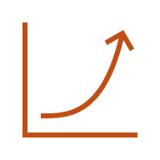
DAF Grantmaking Holds Steady
DAF donors continue to respond and give generously, demonstrating steadfast support for nonprofits.
$54.77B
Total Grants in 2023
Second year over $50B
+92% since 2019
+456% since 2013
Grants have grown significantly over time
Source: National Philanthropic Trust, 2024 DAF Report
Notes:
Grantmaking activity also remained strong. In 2023, DAFs distributed $54.77 billion in grants—providing critical support to nonprofits across all sectors.
This marks the second consecutive year that grant value exceeded $50 billion, just slightly below 2022’s record high.
To put that in perspective: grant dollars were 92% higher than in 2019, before the pandemic—and up an incredible 456% over the past decade.
This sustained level of giving suggests that DAF donors are highly responsive and committed to supporting the causes they care about.

Slide 8
Activity at DAFs vs. Private Foundations
Big giving from a smaller asset base
$251.52B
Donor-Advised Funds
DAFs granted 48%
as much as PFs
Despite holding only 17% of the assets
DAF Grants: $57.46B
$1.48T
Private Foundations
PF Grants: $120.15B
NPT's 2024 Donor-Advised Fund Report, Foundationmark.com
Notes:
Next, let’s compare activity at DAFs versus private foundations.
Now, I want to be clear—this isn’t about pitting donor-advised funds against private foundations. Foundations can be a great fit for certain donors and often complement DAFs in broader philanthropic strategies.
But when we look at grantmaking efficiency—grant dollars as a percentage of assets—the comparison is striking.
In 2023, DAFs granted out nearly half as much as private foundations—48%—while holding only 17% of the total assets.
To put numbers to that: DAFs held an estimated $251 billion in charitable assets, compared to $1.48 trillion held by private foundations. (Source: NPT 2023 DAF Report and FoundationMark.com)
These numbers underscore the agility and active grantmaking behavior we’re seeing from DAF donors.

Slide 9
Who are DAF Donors?
DAFs donors are the same donors you cultivate.
DAF donors are diverse in their giving approaches but tend to be older and affluent.
  Average age: 67
  Average net worth: $1M+
DAFs play a significant role in donors’ overall giving.
  48% gave 75%+ of their charitable dollars through DAFs
  Younger generations are adopting DAFs at higher rates
  22% versus 8%
NPT DAF Industry Insights:
Average DAF size: $141,120
Average payout: 20%+ annually
Source: DAF Research Collaborative, 2025 National Survey of Donor-Advised Fund Donors; National Philanthropic Trust, 2024 DAF Report
Source: National Philanthropic Trust, 2024 DAF Report
Source: National Philanthropic Trust, 2024 DAF Report
Source: National Philanthropic Trust, 2024 DAF Report
Notes:
Let’s take a moment to talk about who DAF donors really are.
In many cases, they’re donors you already know and work with.
According to the Donor-Advised Fund Research Collaborative, DAF donors tend to be older, affluent, and highly engaged in philanthropy.
In fact, nearly half—48%—of surveyed donors gave more than 75% of their total charitable contributions through a DAF over the past three years.
But giving patterns are starting to shift. A recent Bank of America study found that younger generations are more likely to use structured giving vehicles, including donor-advised funds.
DAF accounts themselves vary widely—some hold modest balances, while others hold tens or even hundreds of millions.
What unites DAF donors across generations is their active commitment to giving. The average payout rate from DAFs remains over 20% annually—more than four times what’s required of private foundations.

Slide 10
Decoding the DAF
There is a misconception that the $251 billion in DAFs is fully inaccessible. However:
DAFs are opened and advised by the donors you cultivate.
DAFs are charitable tools used by your
very own donors as charitable savings. Putting away charitable dollars helps keep grantmaking funds available even in lean times.
Some evidence suggests that DAF grantmaking is more recession-proof than other forms of giving.
Most DAF sponsors are agnostic, and you cannot appeal to them directly. What you can do is better cultivate DAF donors and make
it easier for them to recommend DAF grants
to you.
Source: National Philanthropic Trust, 2024 DAF Report
Source: National Philanthropic Trust, 2024 DAF Report
Source: National Philanthropic Trust, 2024 DAF Report
Source: National Philanthropic Trust, 2024 DAF Report
Notes:
There’s a common misconception that money in DAFs just sits idle. But in reality, those funds belong to donors you’re already cultivating—donors who are looking for the right opportunities to give.
Think of a DAF as a ready reserve for philanthropy. The key is to engage it.
In fact, as we already mentioned, DAF grantmaking has proven to be more resilient during economic downturns than other forms of giving—suggesting that donors with DAFs remain active and committed, even in uncertain times.
It’s also important to remember: DAF sponsors don’t make funding decisions. We don’t direct grants—we simply support donors in fulfilling their charitable goals.
That’s where you come in. By better identifying and cultivating DAF donors, and by making it easier for them to recommend grants to your organization, you can tap into this growing source of support.

Slide 11
  Engaging DAF Donors
Donors can do a lot with their DAFs.
What can YOU do to engage with them?

Slide 12



Donors Can Recommend Grants to Their Favorite Charities
Provide reliable, recurring
grants for familiar organizations out
of a sustainable charitable funding source
Draw on this charitable reserve to support exciting new projects
Notes:
DAFs serve as a reliable and flexible source of charitable funding.
They make it easy for donors to set up recurring grants—providing steady support over time.
Donors can also use their DAFs to fund new projects.
Sometimes it may appear that donors are “warehousing” funds in a DAF instead of giving directly to charities—but in most cases, it’s not a delay, it’s a strategy.
Think of it not as a warehouse, but as a greenhouse—a place where future philanthropy is cultivated and prepared. Donors use DAFs as a charitable reserve, setting funds aside with the intention of making thoughtful, sustained contributions over time.
This approach is especially useful for donors with variable income—like business owners—or those nearing retirement who want to ensure they can continue giving even after their regular paychecks stop.
In that way, DAFs help donors stay engaged and impactful, no matter their financial season.

Slide 13



Charities Can Target Your DAF Donors
Treat your DAF donors like major gift donors. (There is more where that came from!)
Let your donors know how you will credit grants made from their DAFs. (Often, the donor gets soft credit, and the DAF account gets hard credit.)
Set up meetings with donors who give through DAFs and ask them to consider major gifts or multi-year pledges.
Notes:
Adopt the mindset that any donor might have a DAF—even if they haven’t mentioned it.
Make it a standard part of your appeals and donor conversations to ask whether they plan to give through a donor-advised fund.
Consider adding a way for donors to indicate this on pledge cards or donation forms, so you can track and match incoming DAF grants back to the individual donor.
A common mistake is to treat grants coming from a DAF sponsor as anonymous or separate from the donor who recommended them.
Whenever possible, be sure to credit the donor directly. If donors feel overlooked or unacknowledged, it can put future giving at risk.
The best practice is to give “hard credit” to the DAF sponsor for legal and tax purposes—but also “soft credit” to the individual donor for recognition in campaign totals, annual giving reports, and board member acknowledgments. This dual approach helps maintain strong donor relationships and encourages continued generosity.

Slide 14
DAF Considerations | Soliciting and Acknowledging DAF Grants
Best practices for nonprofits:
Send thank-you letters that express gratitude without stating that the contribution is tax-deductible: The donor received a tax deduction when contributing to the DAF, not when the grant is made to your organization.
Use non-binding language for pledges: IRS rules permit DAF grants to fulfill multi-year pledges, provided the grant letter does not reference a binding obligation.
Get in touch with your local Community Foundations. Community Foundations are sometimes open to receiving materials and LOIs about opportunities for funding. Timing is everything.
Notes:
It’s important to follow best practices when sending acknowledgment letters for grants received from donor-advised funds.
Thank-you letters should never state that the grant is tax-deductible. The donor already received their tax deduction when they contributed to the DAF—there is no additional tax benefit when the DAF makes a grant to your organization.
Also, keep in mind recent IRS guidance from 2017 regarding multi-year giving through DAFs. Grants from DAFs can be used to satisfy multi-year giving intentions but the grant can’t reference the pledge. And it can't provide the donor with a more-than-incidental benefit. So, no mention of it in the grant letter, no notes in the memo. And no recognition that links back to it.”
As a fundraiser, the best approach is to avoid soliciting legally binding multi-year pledges from DAF donors. Instead, offer a non-binding Intention to Support document that can be kept on file with both the donor and your organization.
If your organization requires a legally binding commitment—for example, to record a receivable—many DAF sponsors are willing to enter into multi-year grant agreements directly with you on behalf of the donor.
Understanding and respecting these guidelines helps maintain compliance while cultivating strong, lasting donor relationships.

Slide 15
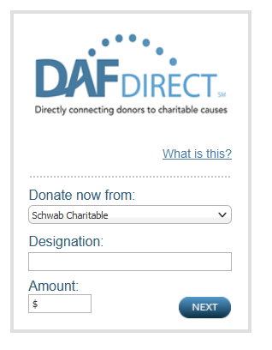
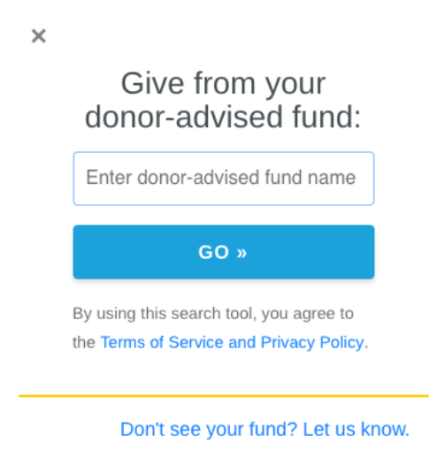
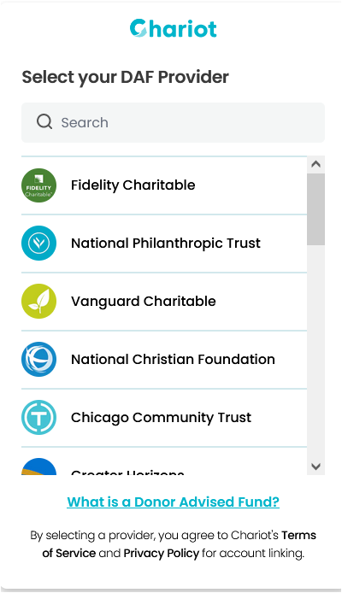

More DAF Considerations | Setting Your Organization Up for DAF Grants
Best practices for nonprofits:
Use a widget to communicate the interest of your nonprofit to receive DAF grants. Donors can access their funds by linking directly from your website. Be aware of potential security concerns on behalf of your donors if you use a widget.
Donors who have DAFs give more money when using the DAF than when making a gift directly to your organization. Three studies show an average between $2,500 to $5,000 per gift, depending on the data source.
Donors with DAFs make 49% of their gifts in November & December. Research shows more than half of the funds are distributed the rest of the year.
2/3 of DAF holders are Boomers and older. 21% of DAF holders are GenX. Don’t ignore your GenZ and Millennials who might also have a DAF. Generational wealth transfer is underway.
Notes:
Second bullet support data (source below):
• First-time DAF gifts are nearly nine times larger than their previous support levels
•DAF donors show consistently higher retention, with 59% retained year-over-year vs 46% for non-DAF donors (+13 percentage points)
•Great for donors of all sizes. Approx. 69% of all DAF grants in 2024 were $1000 or less.
•In 2024, the median DAF revenue growth across nonprofits was +30%, while non-DAF giving declined by about 1%
•In 2024, the median DAF revenue growth was +30%, while non-DAF giving declined 1%
•Among donors converting to DAFs, 85% increased or maintained support levels
•DAF income as a portion of total revenue rose dramatically for smaller nonprofits (<$10M), jumping from 6% in 2020 to 15% in 2024
•Large nonprofits (>$150M) also saw growth, with DAFs moving from 10% to 11% of total revenue in the same period
Source: DAF Fundraising Report 2025, Chariot.

Slide 16


Even More DAF Considerations | Be Findable to be Fundable
Best practices for nonprofits:
Set up your PayPal Charity Account. Donors can see you are a verified charity.
Be sure your legal name matches your materials online and when communicating with donors. If your name doesn’t exactly match what’s on your 990 or on your IRS Determination Letter, donors may not be able to find you
Donors with DAFs like to visit Candid/Guidestar (BBB Wise Giving Alliance, Charity Navigator) according to the largest DAF institutions serving greater Philadelphia. Research shows that having an updated profile makes a difference to funders looking for details about your organization’s programs, finances, and impact.
Some funders have their own grants (Vanguard Charitable, Goldman Sachs Philanthropy Fund, some community foundations). These are the exceptions, not the rule.

Slide 17
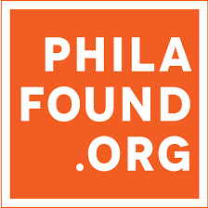
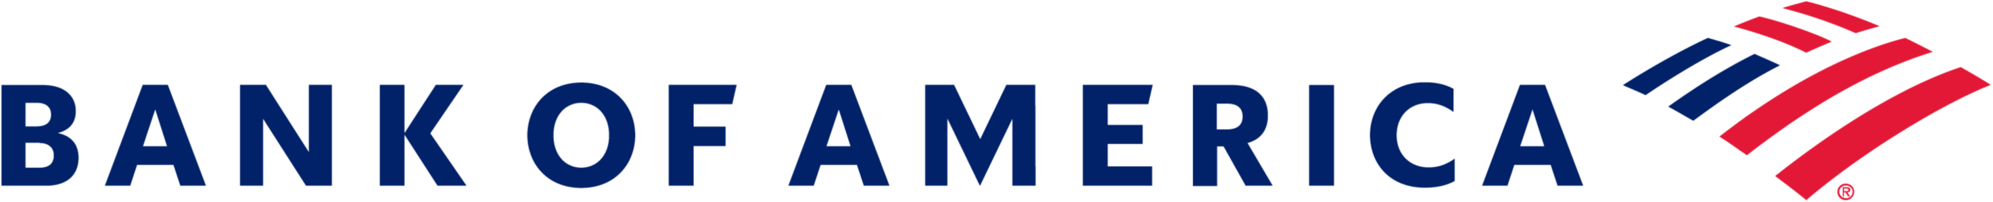
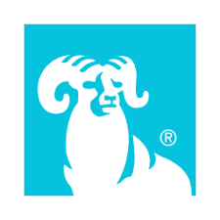
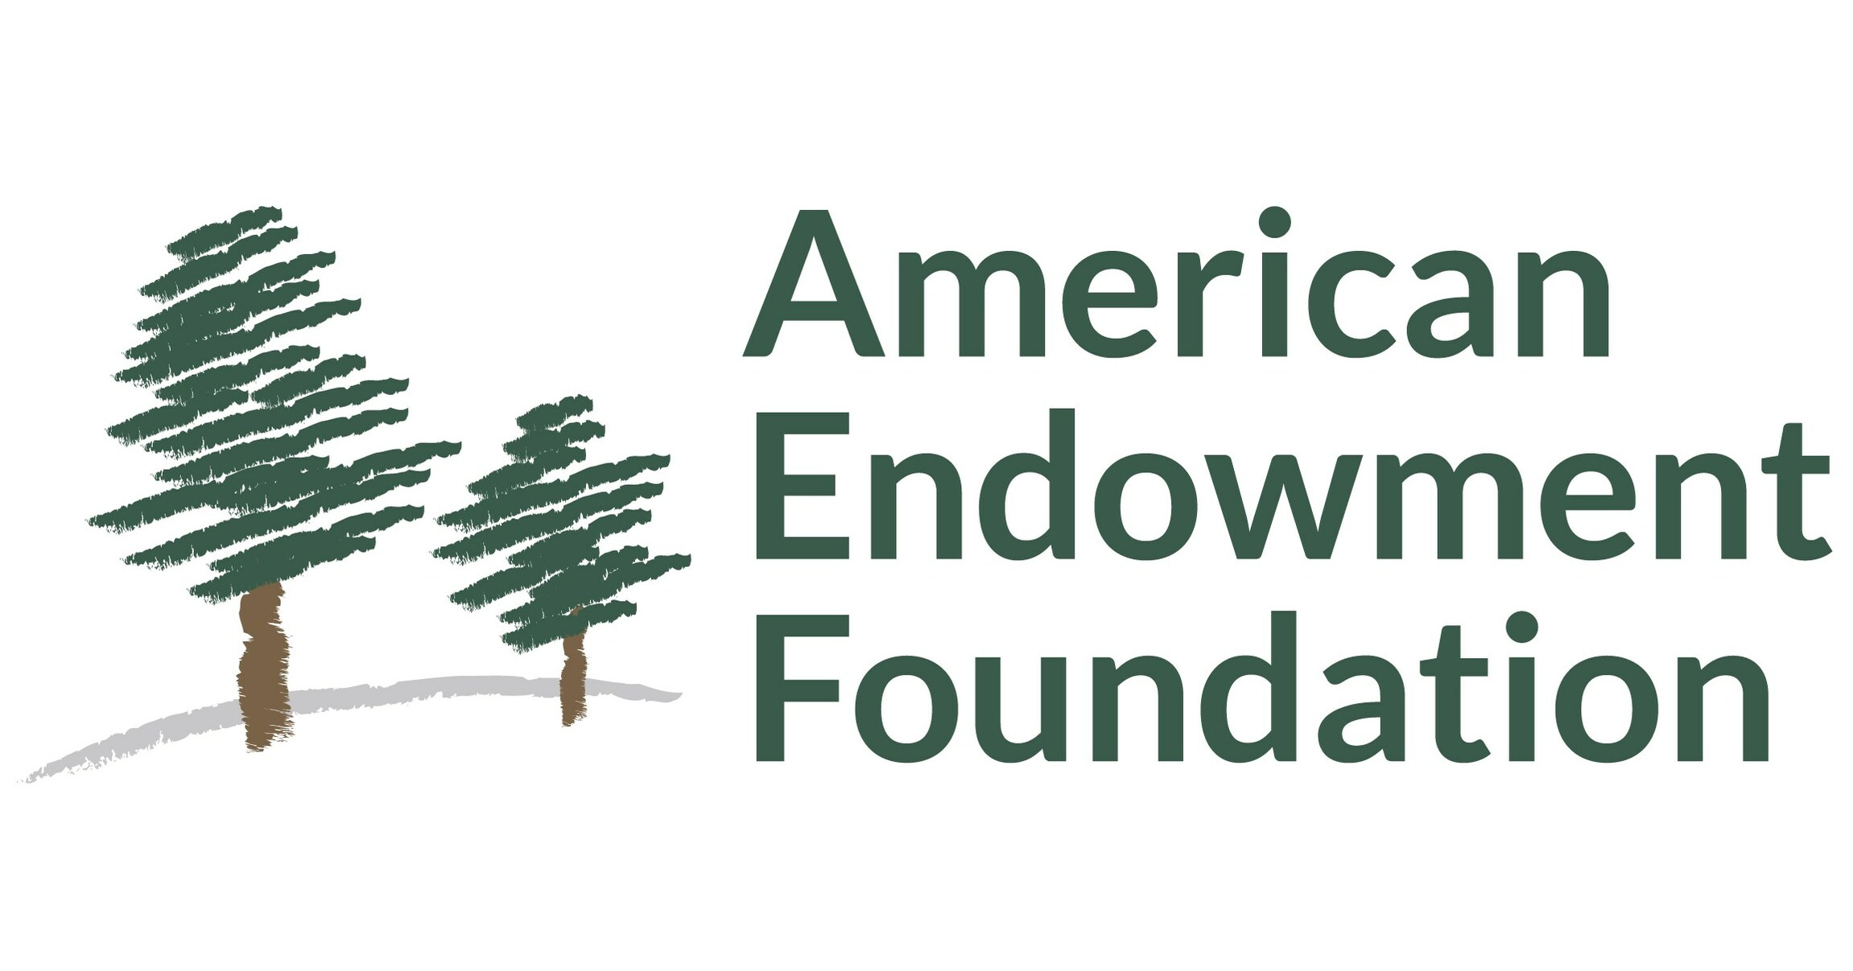
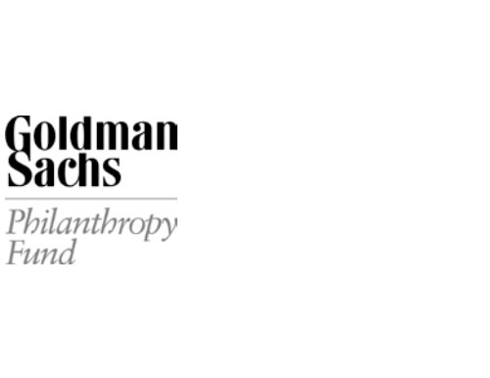
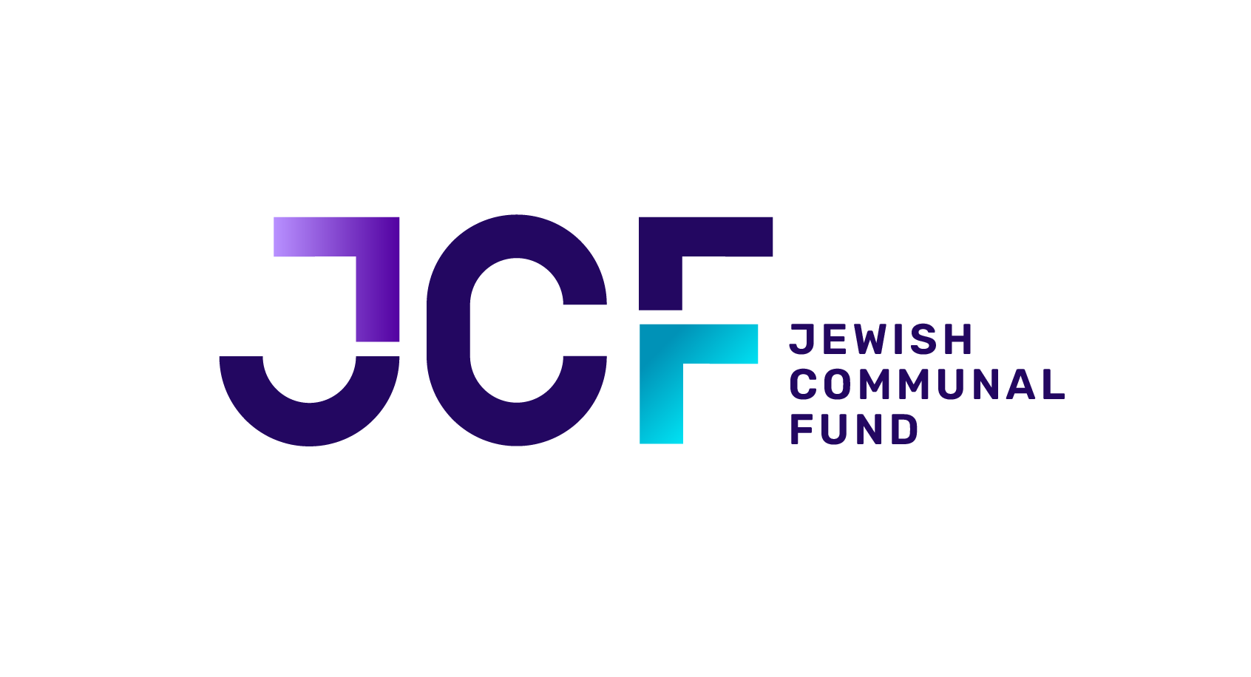
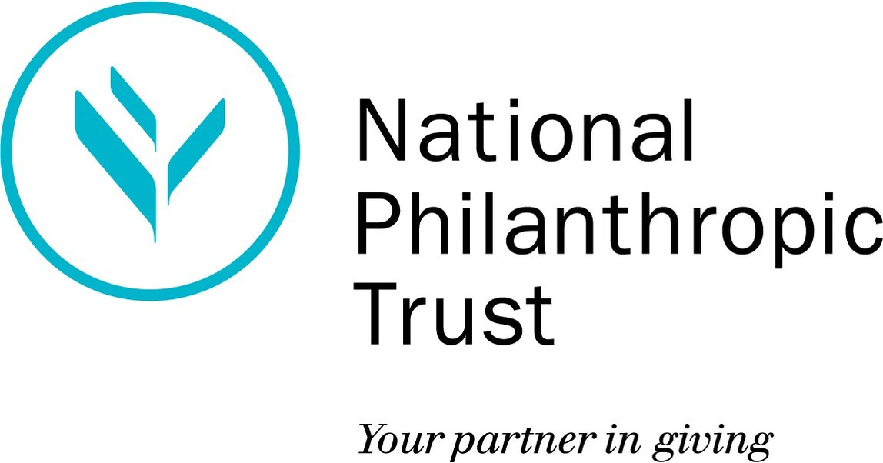
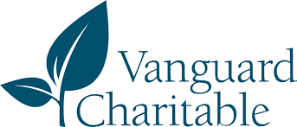
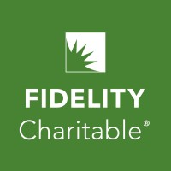
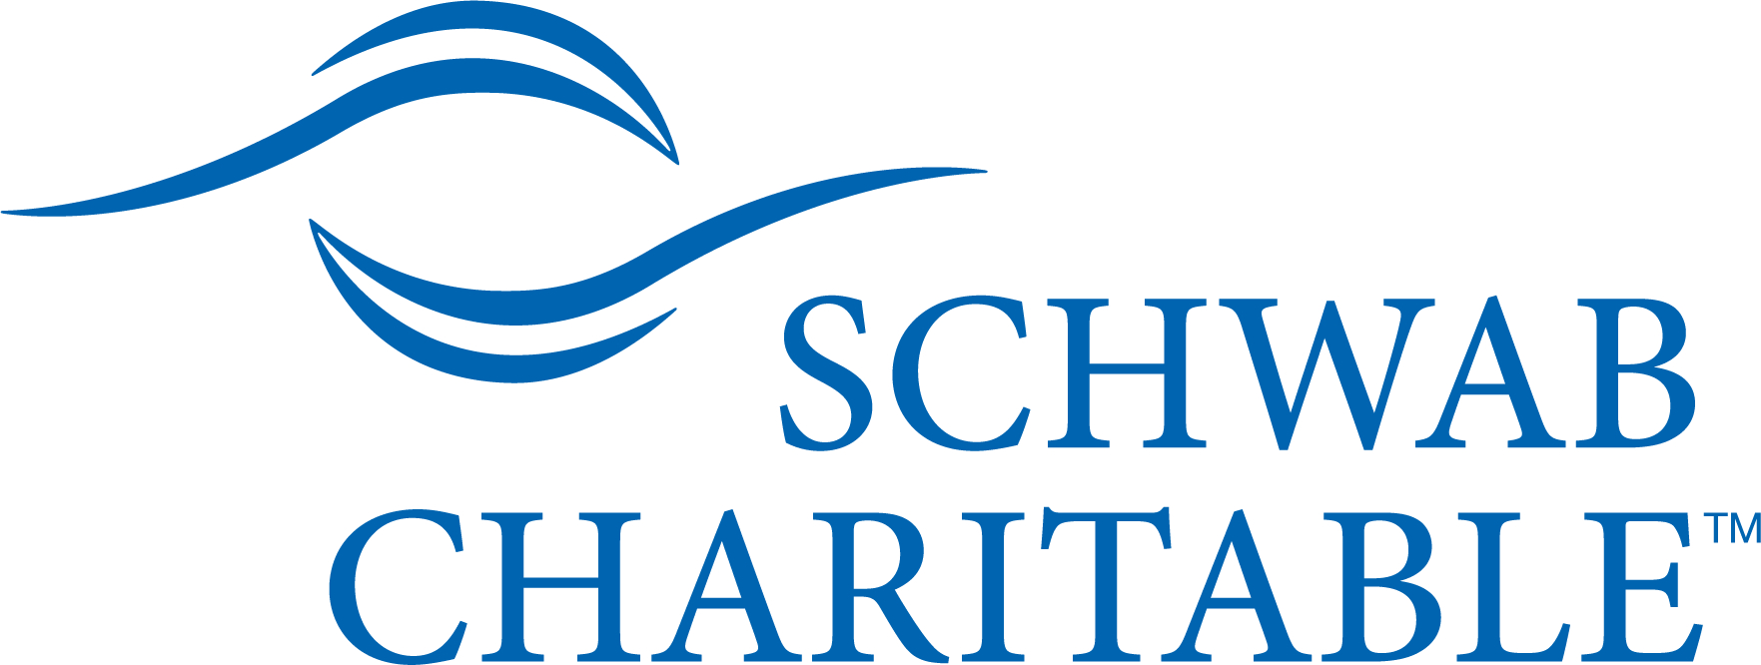
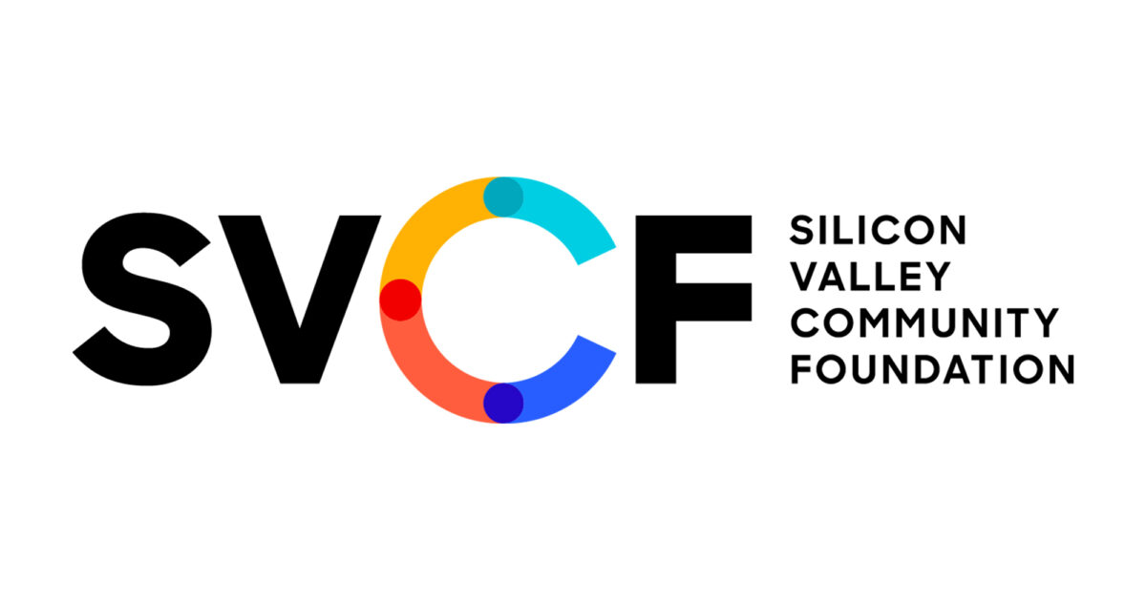
Research| Over 90% of DAF Grants to Nonprofits in Greater Philadelphia

Slide 18
DAF Considerations | Incidental Benefits
DAF grants may not provide more than an incidental benefit to the donor.
Permissible
Supporting a charitable event or gala generally
Receiving name recognition in accordance with level of support
Supporting a find-a-cause/ fund-a-need/ paddle raise
Not Permissible
Paying for any part of a ticket to attend a charitable event, including the tax-deductible portion of the ticket.
Paying for auction items or raffle baskets
Receiving benefits that would not be available without having made the grant.
Notes:
We’ve talked about the importance of following best practices when receiving and acknowledging DAF grants—and part of that is understanding the rules that govern how DAF funds can be used.
That’s where DAF sponsor due diligence comes in.
Have you ever received a call from someone who wasn’t your donor, asking you to verify the purpose of a particular charitable fund?
That was likely a DAF sponsor employee making sure the grant complies with IRS regulations.
DAF sponsors are legally required to ensure that grants are used only for fully tax-deductible charitable purposes.
This is especially important when it comes to events or donor benefits.
For example, DAFs cannot be used to pay for anything that provides a personal benefit to the donor—like gala tickets, membership perks, or auction items.
To avoid any confusion or frustration, it’s a good idea to proactively communicate these limitations with your donors.
That said, many event-related contributions—like paddle raises, sponsorships with no benefits, or donations tied to specific causes—are perfectly allowable uses of a DAF.
Clarity on these points helps you avoid issues, manage donor expectations, and strengthen those important relationships.

Slide 19

Donors Can Streamline Their Giving
One donation, many grants
Donors contribute to their DAF — often during high-income years for tax purposes — and then recommend grants to multiple nonprofits over time. This simplifies their tax reporting and giving process.

Slide 20
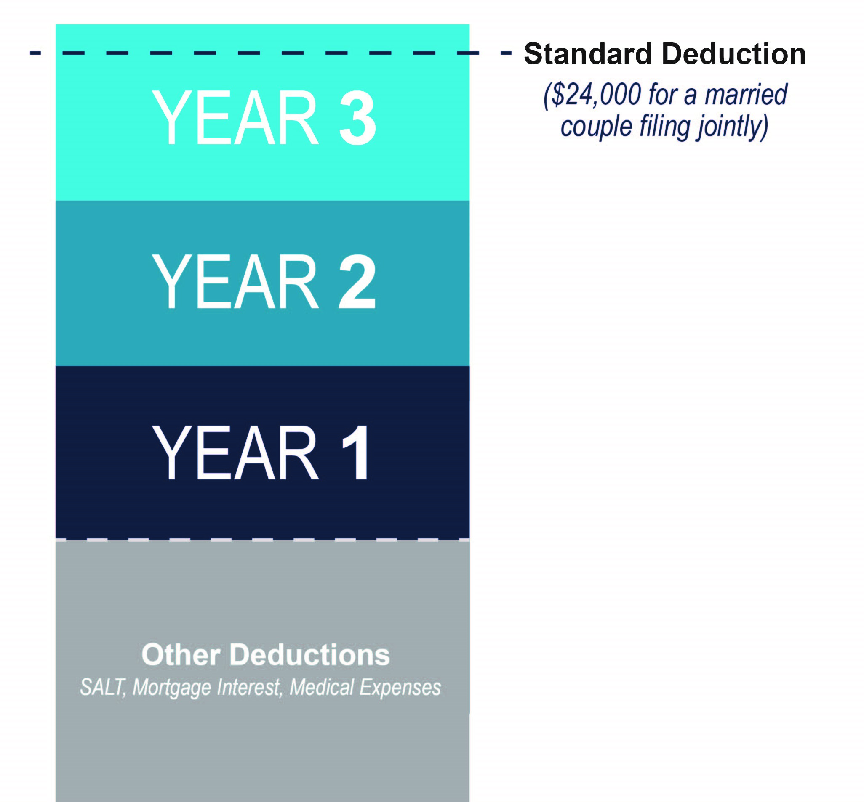
Donors Can Streamline Their Giving
Donors can “bunch” or “bundle” by contributing several years’ worth of giving to their DAF at a time, itemizing their deductions for that year with a single tax receipt, and having the funds ready for future grantmaking to any number of organizations.
($30,000 for a married couple filing jointly)
Other
Deductions
SALT, Mortgage Interest, Medical Expenses
Notes:
The Tax Cuts and Jobs Act of 2017 significantly increased the standard deduction, which has cut the number of taxpayers who itemize their deductions in half.
For 2024, the standard deduction is $14,600 for single filers and $29,200 for married couples filing jointly.
As a result, many individuals and families now simply take the standard deduction instead of itemizing charitable contributions.
One effective strategy to maximize tax benefits is “bunching” several years’ worth of charitable gifts into a donor-advised fund in a single year.
By doing this, donors push their total deductible contributions above the standard deduction threshold, allowing them to itemize and claim a tax deduction for the full amount donated that year.
In the alternating years, they can take the standard deduction and still support their favorite charities by recommending grants from their DAF—smoothing out the impact on both the donor and the charity.
For example:
A married couple has $10,000 in deductions from SALT, mortgage interest, and medical expenses, and typically gives $10,000 annually to charity.
By bunching three years’ worth of charitable giving into a DAF—$30,000 in total—they exceed the $29,200 standard deduction threshold for married filers, enabling them to itemize and realize tax savings in that year.
This strategy creates a tax-smart giving plan while ensuring consistent support for charities over time.
Another way donor-advised funds support thoughtful, sustained giving is by allowing donors to frontload their philanthropy.
Many donors choose to make a large contribution to their DAF in a year when they have a higher-than-usual income—whether from a business sale, a bonus, or another financial event.
That single contribution can then be used to fund years’ worth of grantmaking.
This strategy offers multiple benefits: donors receive a full charitable deduction in the year they make the contribution, but they’re not rushed to decide where every dollar should go.
Instead, they can take their time, support charities consistently over several years, and adapt their giving to respond to emerging needs or priorities.
For fundraisers, it’s helpful to understand this dynamic—because a donor’s visible giving may not match the moment they received their tax deduction.
By recognizing this long-term approach, you can better engage DAF donors year after year and position your organization for sustained support.

Slide 21

Charities Can Include DAF Info in Solicitation Material
If donors choose DAFs because it
makes giving easy, make giving to your organization easy.
Prominently list your EIN online
and in development materials.
Including DAF grant instructions in your materials signals your understanding of this giving method and builds donor trust.
On your response mailer, request that your donors indicate whether they will give from a DAF; this will help you match the grant to the donor and credit them appropriately.
Notes:
To encourage DAF donors to give to your organization, it’s essential to make the process as easy and straightforward as possible—and to clearly signal that you understand how DAFs work.
Start by prominently displaying your organization’s Tax ID number on your website.
If your charity appears on GuideStar or Candid under a different name—such as “XYZ DBA (doing business as) ABC”—be sure to include that information as well. This helps donors and DAF sponsors accurately identify your organization when making grants.
Keep in mind that DAFs can have a wide variety of names, often reflecting the donor’s own name or family foundation—for example, a grant might come from something like “The [Donor Name] Foundation.”
Being transparent and clear about your organization’s legal and tax details will reduce confusion and make it easier for donors to recommend grants to you.

Slide 22


Donors Can Establish a Charitable Legacy with Creative Estate Planning
Name a DAF as Beneficiary
Grant
Posthumously
Appoint
Successor Advisors
Name a DAF as a beneficiary of a will, trust, retirement account, life insurance policy or other estate-planning vehicle.
Direct one-time or recurring grants to charitable organizations to be made after their passing.
Appoint successor advisors to continue recommending grants, fostering a multi-generational tradition of giving.
Many donors are converting their foundations to DAFs to relieve their administrative burden and simplify their tax filings.
Notes:
DAFs can play a powerful role in legacy planning.
Donors have the option to name a donor-advised fund as a beneficiary of their will, trust, retirement account, or life insurance policy.
They can also use their DAF to direct one-time or recurring grants to be made after their passing, and appoint successor advisors—often their children or other family members—to carry on the family’s tradition of giving.
We’re also seeing a growing trend of donors converting private foundations to DAFs.
Many charitable families initially set up private foundations to manage their philanthropy, but these can create significant administrative burdens for heirs who may not want that responsibility.
As Baby Boomers age, some are choosing to convert their foundations to DAFs and appoint their children as secondary advisors or successors to the DAF account, rather than as trustees of a foundation.
This approach reduces the time and cost involved in operating a foundation, while still enabling families to collaborate on their philanthropic goals across generations.

Slide 23

Charities Can Segment DAF Donors for Planned Giving Appeals
DAF donors already have to think about succession planning, which makes them good candidates for planned giving.
Work with them to name your organization as a charitable beneficiary to their DAF.
Cultivate DAF donors through family-friendly events
to facilitate engagement with younger generations.
Notes:
What can charities do to effectively segment DAF donors for planned giving appeals?
When donors set up their DAFs, they often think about succession and legacy planning—making them strong prospects for planned giving conversations.
One effective approach is to identify donors who are currently giving through DAFs and send them a personalized letter inviting them to consider naming your charity as a beneficiary in their DAF’s succession plan.
You can also invite these donors to join your Legacy Society or other planned giving recognition programs, helping to deepen their engagement and commitment over time.
By proactively reaching out to DAF donors with this tailored messaging, you position your organization to build lasting philanthropic relationships.

Slide 24
Donors Can Convert Complex Assets into Charitable Capital
DAFs offer donors the ability to donate a wide range of assets:
Publicly traded stock
Restricted stock
Private business interests
Alternative investments
Real estate
Art and other tangible
property
Cryptocurrency
And more
Direct contribution affords donors significant tax
savings over donating the proceeds from the assets’ sale.
Notes:
This is what I do every day—help organizations and donors navigate these opportunities.
Every nonprofit has different capabilities, and gift acceptance policies can vary widely.
For example, imagine an entrepreneur going through a major business transaction. They may find it hard to make time to give to multiple charities or to think strategically about their philanthropy in the moment.
Using a DAF allows them to make a gift quickly, then develop a giving strategy later.
It also opens up a donor’s balance sheet—enabling them to give from assets rather than, or in addition to, their income.
This flexibility makes philanthropy more accessible and strategic for many donors.
When it comes to wealth events, donors can earn their tax deduction during the planning phase—allowing them to think long-term and strategically about grantmaking.

Slide 25

Charities Can Partner With a DAF to Accept Complex Assets
Conduct an honest assessment of your organization’s ability to accept the assets your donors might be looking to give.
Some organizations might be good candidates
for a designated fund, to which donors can contribute their illiquid gifts for your
organization’s benefit.
Notes:
Donor-advised funds act as a third party and often provide specialized expertise to help manage complex gifts. Well-known sponsors like NPT, Fidelity Charitable, SVCF, and advisors such as Bryan Clontz at Charitable Solutions LLC offer valuable support.
Even larger charities may struggle to accept complex assets directly due to the risks and operational demands involved.
Handling these gifts often requires coordination with legal counsel, finance, risk management, and real estate teams—busy offices that may not prioritize these transactions.
This can lead to a less-than-ideal donor experience.
Rather than saying “no,” try saying “maybe.”
Learn as much as you can about the asset and consider partnering with a DAF to facilitate the gift.
Another option is a designated fund, where your charity is the sole beneficiary of the account.
Unlike a DAF, the donor doesn’t retain advisory privileges.
This structure acts as a pass-through vehicle to accept complex assets, liquidate them (usually charging a small processing fee of 1–3%), and then transfer the proceeds to your organization.
Designated funds can be a smart way to simplify complex gifts and ensure your charity receives valuable support.

Slide 26

DAF Considerations | NPT’s Illiquid Asset Contribution Guidelines
NPT evaluates contributions by considering the following:
Ownership
Who owns the asset? Is ownership transferable?
Are there restrictions?
Risk & Cost
Are there liabilities, legal risks, or holding costs?
Are there tax concerns?
Liquidity
Can the asset be sold?
How long will it take to liquidate?
NPT conducts a thorough due diligence process to determine whether an illiquid asset can be accepted into a donor-advised fund.

Slide 27
Use Case
Illiquid Assets

Slide 28


Use Case: The Situation
Organization
Hopewell Community Health, a regional nonprofit offering mental health services and crisis response programs.
Challenge
Hopewell regularly received DAF gifts, but they weren’t actively segmenting them. They also had little infrastructure to solicit complex gifts.

Slide 29
Use Case: How Hopewell Activated DAF Donors
Identified and Tagged DAF Donors
Development team analyzed past gifts, matched them to donor records, and tagged known DAF donors in the CRM to enable targeted outreach.
Refined Appeal Language
Solicitation materials were updated with DAF-specific giving instructions, making it easier for donors to act.
Segmented for Legacy Outreach
DAF donors aged 60+ were invited to a legacy session, linking current giving to long-term impact.
Activated a DAF Sponsor for Complex Giving
At the session, a donor revealed plans to sell a business. Hopewell introduced them to a DAF sponsor skilled in accepting complex assets.
Outcome: From CRM Tag to $750K Grant
The sponsor accepted the business interest, liquidated it, and the donor recommended a $750K grant to Hopewell, the largest in its history.

Slide 30




Final Takeaways
Communicate how
you credit DAF grants.
Include DAF language
in your solicitations.
Tag and segment
DAF donors.
Cultivate DAF donors
for planned gifts.
Partner with a DAF sponsor
for complex gift administration.
Notes:
You already do a great job connecting donors with opportunities that align with their philanthropic goals and financial planning needs—and a donor-advised fund is one more tool that can help.
To recap:
For fundraisers, the key is to make giving from a DAF to your organization as easy as possible.
Ask yourself: Do you mention DAFs in your solicitation materials?
Including language like “recommend a grant from your donor-advised fund” in your appeals and reply devices—just as you do with checks or credit card options—is a smart and increasingly necessary practice.
It signals to donors that you understand the evolving landscape of charitable giving, which helps build trust.
It also gives you valuable insight into who your DAF donors are.
Once you identify them, you can segment your outreach and tailor your recognition to better match their preferences and patterns of giving.
And remember, DAF donors often think about long-term impact—they have a unique opportunity to create a charitable legacy.
Here’s a tip: Planned giving conversations can sometimes feel uncomfortable. But because DAFs often include built-in succession plans, they offer a natural and less intimidating way to begin that discussion.
DAF donors may also be able to contribute complex assets, like private stock or real estate.
Another tip: Take an honest look at your organization’s capacity and policies around accepting these types of gifts.
If there are gaps, consider partnering with a DAF sponsor.
You could explore setting up your own DAF or designated fund that supports only your organization, or simply encourage donors to use or open their own DAF.
Once you’ve done that, revisit your major donor strategy. Think about how to include donors with complex assets—and be ready to suggest a DAF as part of their giving approach.

Slide 31
Questions

Slide 32
Thank You
Fernando Gonzalez
Vice President, Development, East
National Philanthropic Trust
Phone: (215) 302-4102
Email: fgonzalez@nptrust.org
Perry Monastero, Ed.D.
Principal
RPM Consulting Group
Phone: (267) 972-5341
Email: perry@rpmcg.com

